Slide 1


Tourism management system
Team Members:
Ajay Kumar Chavvakula
Vadde Narendarnath Sai
Harshavardhan Reddy Yaramala
Pranay Vatte
The better way to enjoy your world as a nomad

Slide 2

Pain Points
Decide on a Location
Set Goals and create plan
With out local support they didn't fill their day.
Combining all sectors(Hotels, cabs, restarents,Tourist Gides)

Slide 3
System implementation
Tourist places with the detailed description along with surrounding tourist places and the google map of the places is displayed.
User can choose the tourist place and can able to book the ticket.
User can conform the booking by making payment or cancel the tour.
User can found the history of the bookings and can take the print or download the ticket.

Slide 4



Solutions
With this project all users full fill their tour plans.
We are creating a web application, so that they can manage any tour plans.
Users can create their own account.
They can manage budget of tour.

Slide 5
Market Limitations
There are some applications related to tourism, but we are going ahead of that, like we are offering number of item's in our application.
Our's is web Application.
Only admin have access to modify data on locations.

Slide 6
Target market
Now a days planning tour is easy but implementation is difficult.
With our application clients can do all sort of bookings at a time.

Slide 7
Business model
We are doing a mediator to different fields from users.
With that we can get brokerage from third party owners.
We get paid from users also and with their data we can get paid.

Slide 8
Team Member's role
Ajay Kumar Chavvakula- service integration and deployment.
Narendarnath Sai vadde- database and schema development
Harshavardhan Reddy Yaramala- web development
Pranay Vatte- cloud,Back end and development authentication.

Slide 9
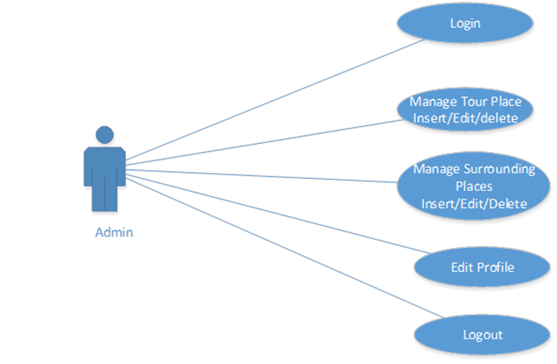
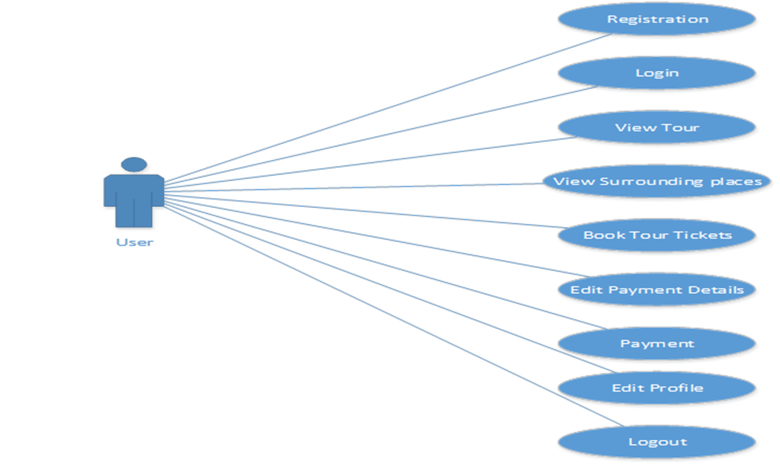
Design

Slide 10
Efforts to communicate team and development tools
Through webex and zoom the developments and implementations are going to be discussed.
The development tools are operating system window 7 or higher .
Using java script and html.
Planning Mysql is the database for the system.
Hardware i3 or above.

Slide 11

Thank you

